Slide 1

Breast Cancer
Machine Learning Model

Slide 2
Problem Statement
Create a Machine Learning Model that looks and predicts if the Cancer Diagnosis is Benign or Malignant based on several features.

Slide 3
Data Description
There are 10 attributes with integer values and the value of class is to be predicted. If the Class has a value of 2 that indicates in that particular example the cancer cells predicted to be benign. Similarly, the value of 4 indicates the cancer cells predicted to be malignant.
Uniformity of Cell Size/Shape : Cancer cells tend to vary in size and shape. That is why these parameters are valuable in determining whether the cells are cancerous or not.
Bland Chromatin : Describes a uniform “texture” of the nucleus seen in benign cells.

Slide 4
Marginal Adhesion : Normal cells tend to stick together. Epithelial cells that are significantly enlarged may be a malignant cell . This term is called marginal adhesion.
Single Epithelial Cell Size : It is a single layer of cells with every cell in direct contact with the basement membrane that separates it from the underlying connective tissue.
Bare Nuclei : This is a term used for nuclei that is surrounded by cytoplasm (the rest of cell ) those are typically seen in benign tumors.

Slide 5
Clump Thickness : Benign cells tend to be grouped in monolayer's, while cancerous cells are often grouped in multilayer's.
Normal Nucleoli : Nucleoli are small basophilic spherical bodies located in the nucleus.
Mitoses : A measure of how fast cancer cells are dividing and growing.

Slide 6
Analysis
This Dataset has a whole of 699 rows which has the particular patient details with their id, level of different tests and the outcome Case.
It then has 11 columns which describe the patient details which are known as features.
All the Independent Features starting from Clump Thickness to Mitoses have their values from varying from a minimum of 1 to a maximum of 10
The Class attribute which is the Dependent Feature (Outcome) has two values 2 and 4, where 2 indicates the cancer cells predicted to be benign and 4 indicates the cancer cells predicted to be malignant.

Slide 7
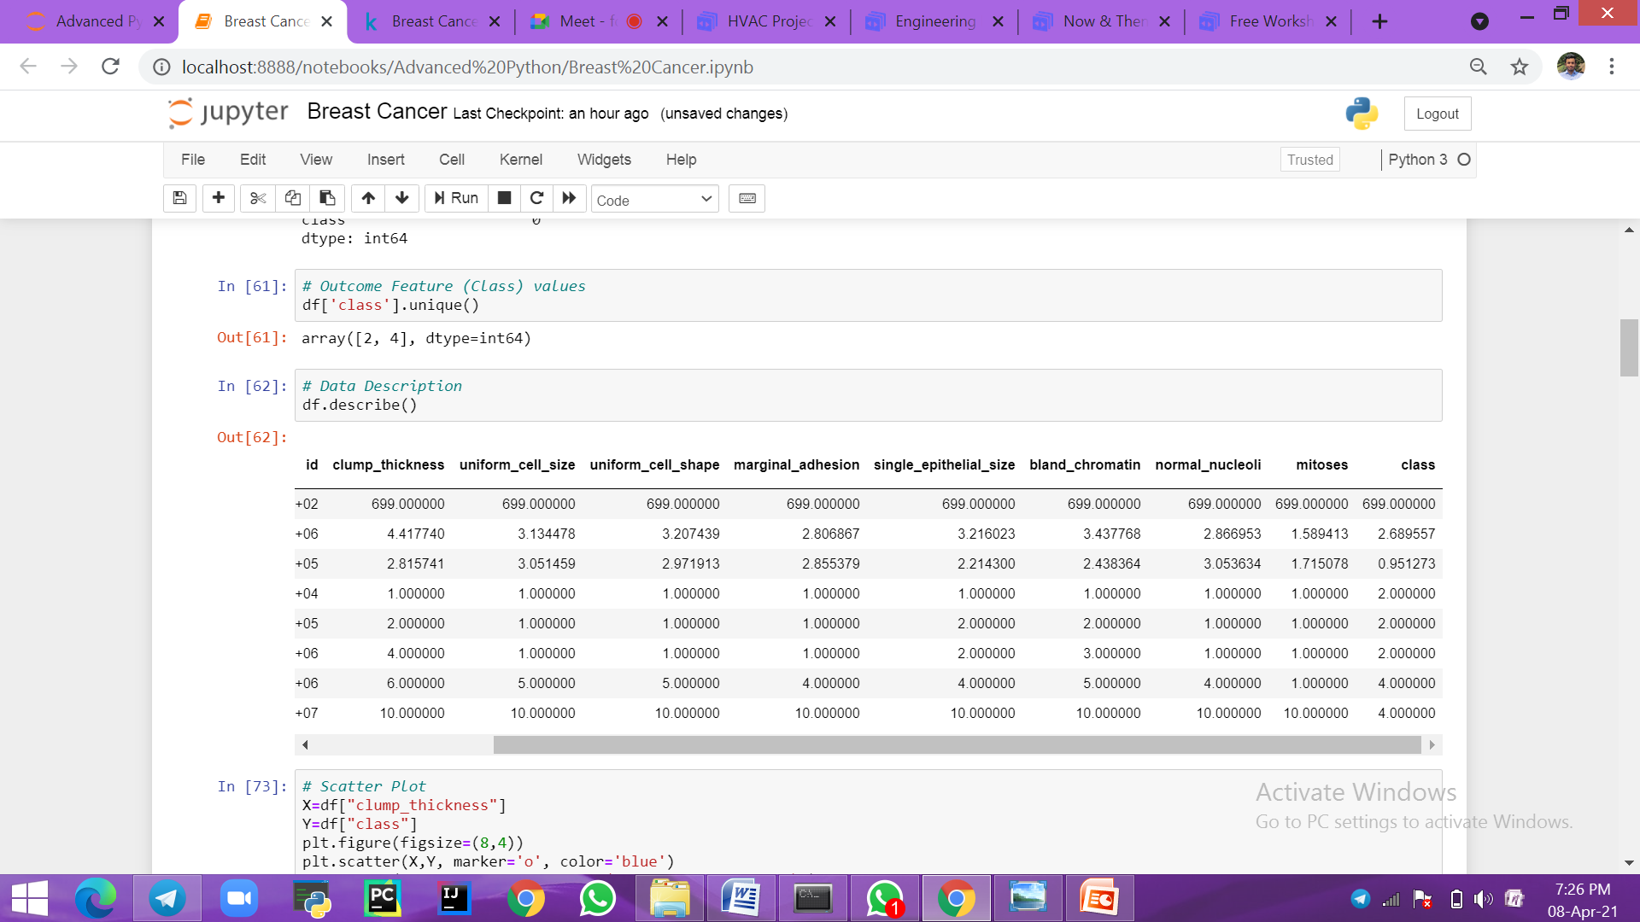
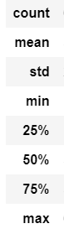
Statistical analysis

Slide 8
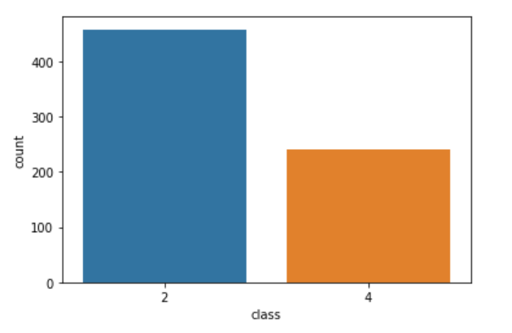
This is the Count Plot which shows the total number of Benign and Malignant Cases which are shown as 2 and 4 respectively.
The Benign Cases ( 2 ) are shown in blue color to the left in the plot, whereas the Malignant Cases ( 4 ) are shown in orange color to the right.

Slide 9
Support Vector machine
A Support Vector Machine (SVM) is a supervised machine learning model that uses classification algorithms for two-group classification problems.
After giving an SVM model sets of labeled training data for each category, they're able to categorize new text. So you're working on a text classification problem.
Supervised machine learning algorithm which can be used for both classification or regression challenges.
The linear SVM classifier works by drawing a straight line between two classes. All the data points that fall on one side of the line will be labeled as one class and all the points that fall on the other side will be labeled as the second.

Slide 10
Accuracy Score
The Accuracy of a machine learning classification algorithm is one way to measure how often the algorithm classifies a data point correctly.
Accuracy is the number of correctly predicted data points out of all the data points.
Accuracy in Breast Cancer Class Prediction :
Acc = 97.14285714285714 %
This shows that 97% of the Predicted Class Values are similar to the Real Class Values.

Slide 11
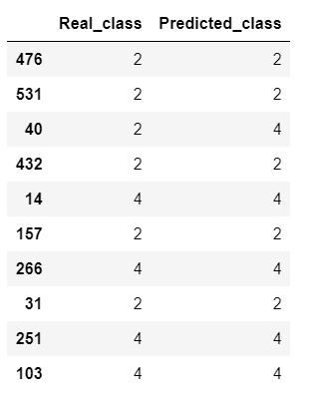
Actual vs Predicted Class
This is the Comparison of the Predicted Class values which were derived through the SVM machine learning model to that of the Real Class values present in the Breast Cancer Dataset.

Slide 12

Neeraj Boyapati
Pamulapati Kirthana
Medam Bhanu Tej
Kannan Archana
Ponnuru Sai Venkatesh
Koye Harshitha

Slide 13


